Slide 1

More Supervised Learning Algorithms

Slide 2

Hey everyone !

Slide 3

01
02
03
04
Support Vector Machines
Tree-based models
K-nearest neighbours
Naïve Bayes

Slide 4
01.
Support Vector Machines :

Slide 5

What you need to know about SVM:
SVM is non-probabilistic linear classifier (although it can be used also for regression and anomaly detection)
SVM builds a model so that different categories (classes) are separated by a clear gap that is as wide as possible

Slide 6
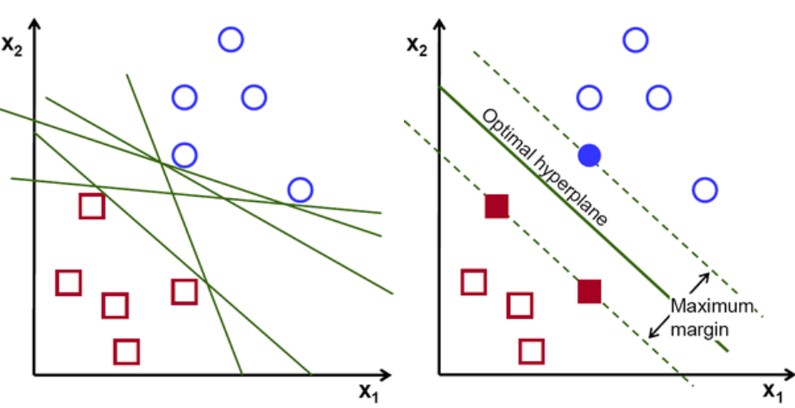
What line should we choose ?

Slide 7
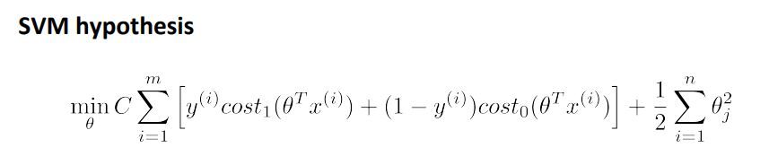
Defining SVM (soft margin SVM) :
*Cost1 and Cost0 refers to hinge loss function

Slide 8
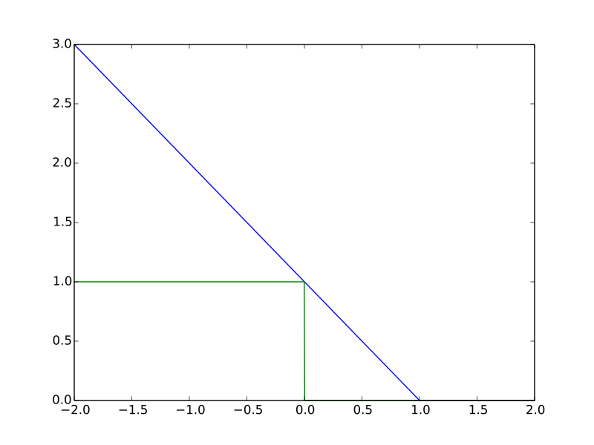
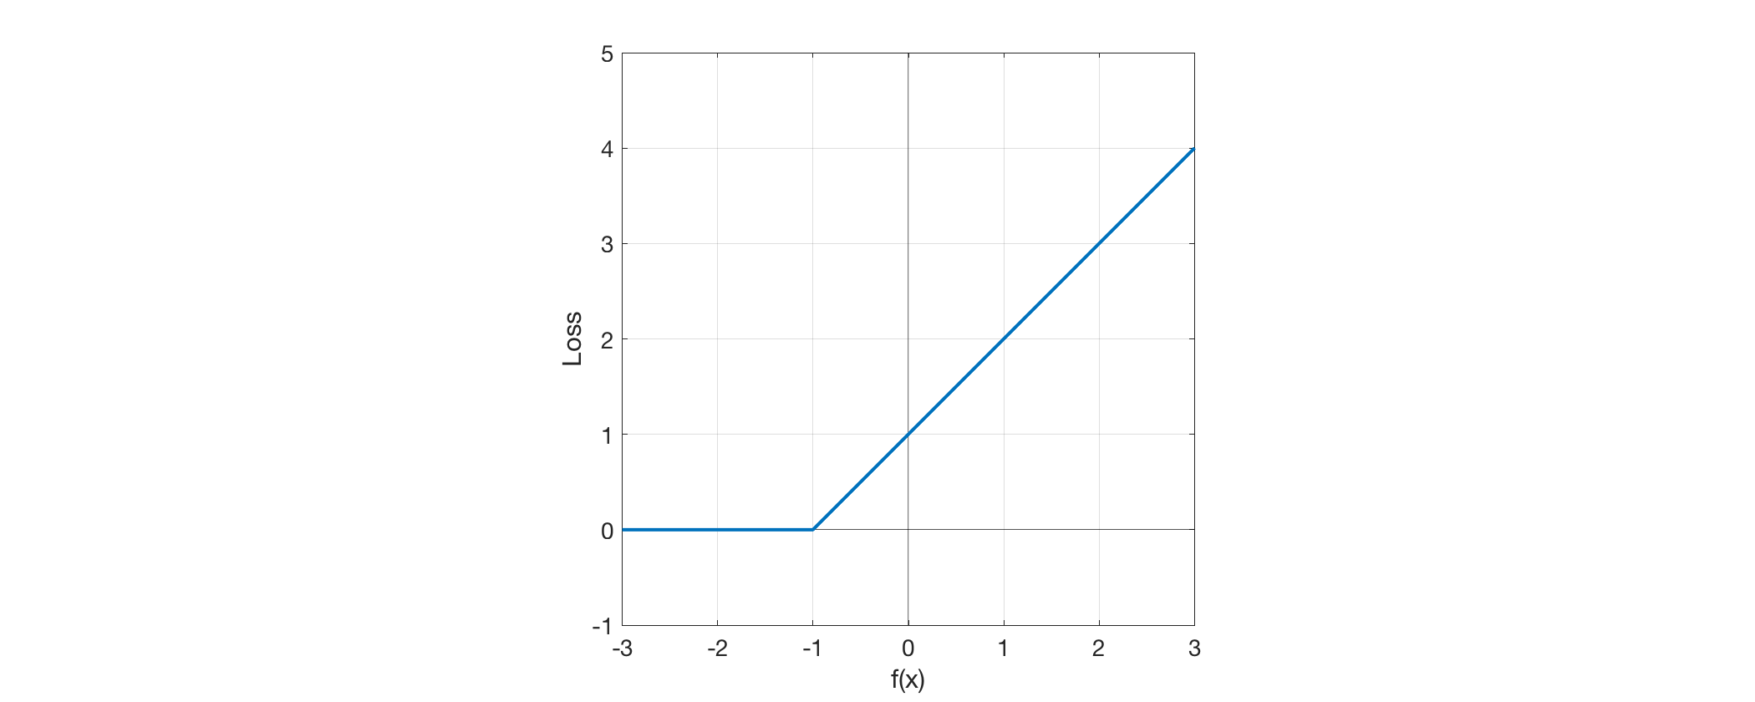
Hinge loss function :
cost1(z)
cost0(z)

Slide 9
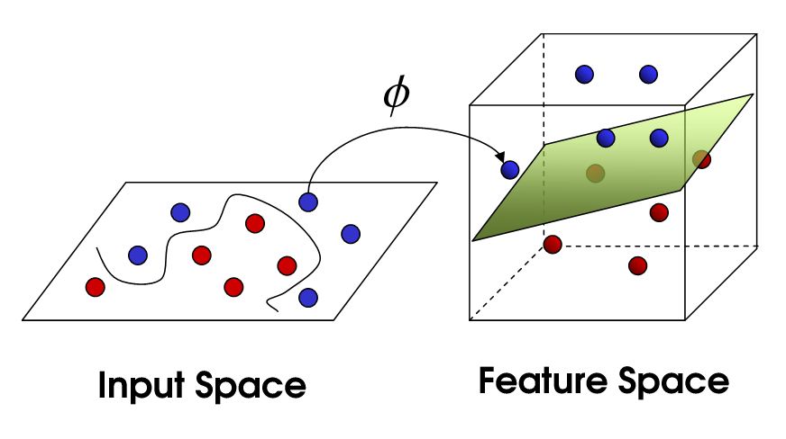
Kernel Trick :
SVM can be efficiently used for non-linear classification using the Kernel Trick
Kernel Trick consists of mapping features to a higher dimensional feature space
Different kernels exist : polynomial kernal, gaussian kernel, linear kernal …

Slide 10
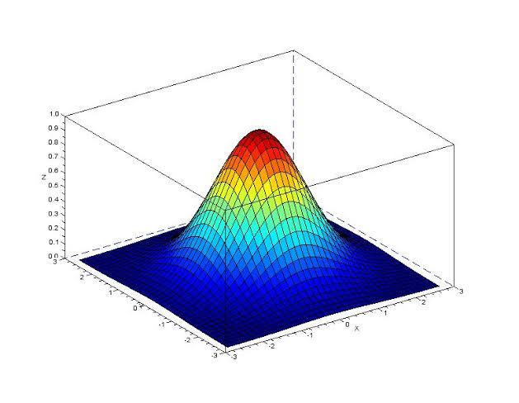
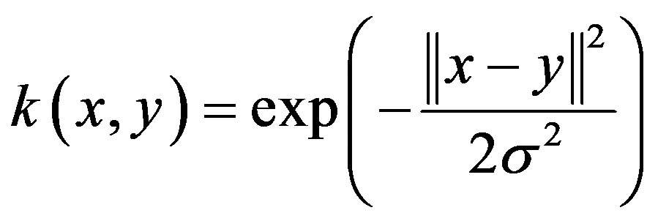
Gaussian kernel (RBF) :
It the most used kernel for SVM
- It calculates the similarity between two points in space

Slide 11
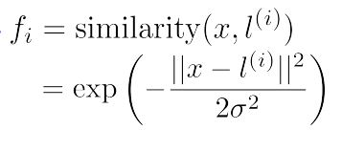
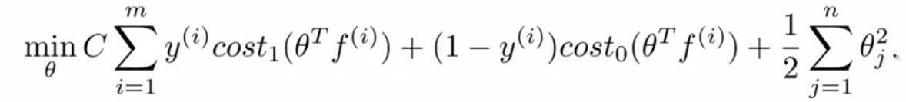
Gaussian kernel :
The new features f i are calculated as follow :
So the new cost function will be :

Slide 12
01.
Tree-based models :
Simple classification and regression trees
Random forests
Boosting trees

Slide 13
What are tree-based models?
A set of predictive models that uses ‘decision trees’ to draw conclusions(predictions) from observations.
They can be used for both classification and regression

Slide 14
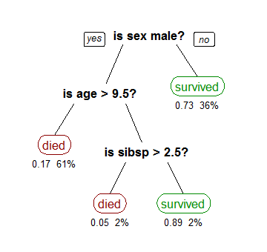
Decision tree :
A tree showing survival of passengers on TITANIC.
Sibsp : the number of spouses or siblings aboard

Slide 15
How to build a decision tree ? (recursive partitioning)
We build a decision tree by learning simple decision rules inferred from the data features.
the tree is built recursively. Each time, We add a node which represents an if-then-else decision rule.
A node is assigned a feature and a splitting point .
Each time, we choose the best feature and spliting point that let us differentiate observations based on the target variable.
We stop the process when splitting no longer adds value to the predictions.

Slide 16
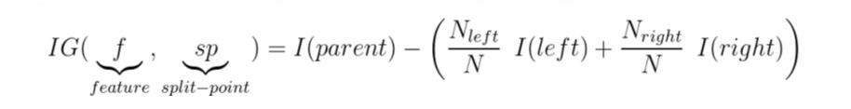
Where to split?
We choose the feature ‘ f ’ and split point ‘ sp ‘ so as to maximize the information gain

Slide 17
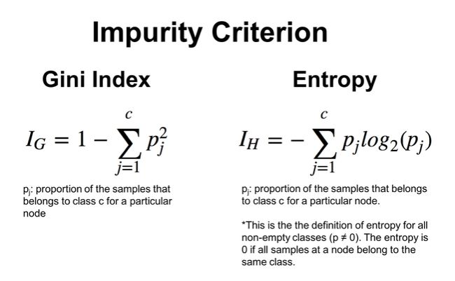
Where to split?
’ I(node) ’ is a criteria that measures the impurity of a node.
- For classification :

Slide 18
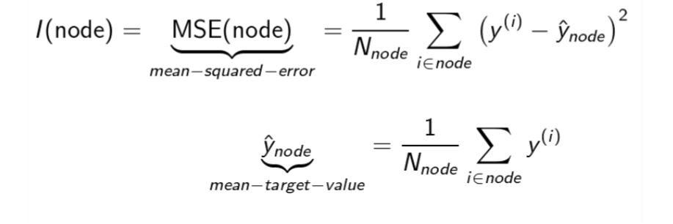
Where to split?
- For regression :

Slide 19
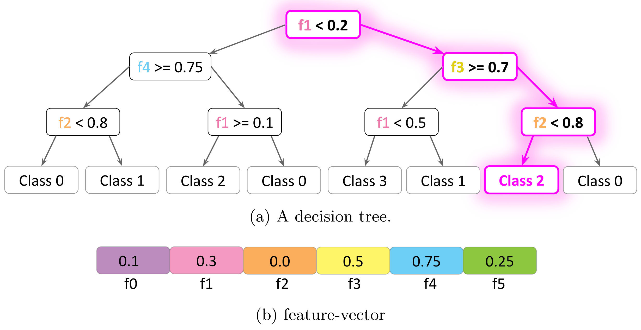
Prediction :

Slide 20
1.2
Random Forests :
Ensemble learning

Slide 21
What are Random Forests?
It is a meta estimator that fits a number of decision tree classifiers on various sub-samples of the dataset.
The model outputs the class that is the mode of the classes (classification) or mean prediction (regression) of the individual trees.

Slide 22
Training :
Each estimator (Tree) is trained on a bootstrap sample.
At each split, we randomly pick x features ( x< nbr_features).

Slide 23
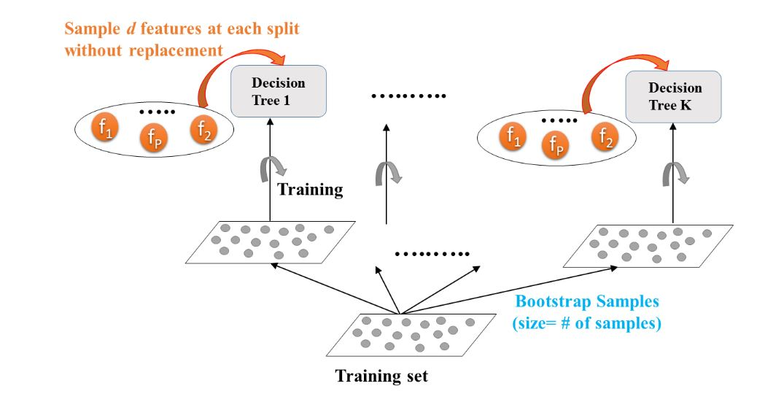
Training :

Slide 24
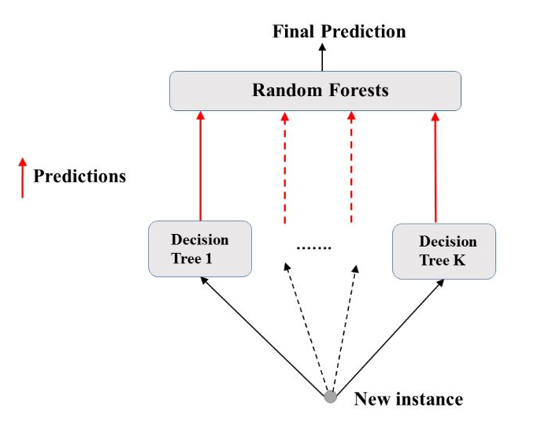
Prediction :

Slide 25
Pros :
The predictive performance can compete with the best supervised learning algorithms
They provide a reliable feature importance estimate.
RFs are good for parallel or distributed computing
Cons :
Lack of an interpretable model
Many hyperparameters to train

Slide 26
1.2
Boosting Trees :
1.2.1 - Gradient boosted trees

Slide 27
What are Boosting trees ?
It is an ensemble method combining several weak learners to form a strong learner.
A weak learner is a model doing just better than random guessing (example : decision tree with max depth of 2)
Each weak learner tries to learn from its predecessors error

Slide 28
1.2.1
Gradient boosted trees :

Slide 29
How Gradient Boosted trees ?
Base learners (the week learners) learn from their predecessor’s errors.
Each base learner is trained on its predecessor residual error
An important part of gradient boosting method is regularization by shrinkage

Slide 30
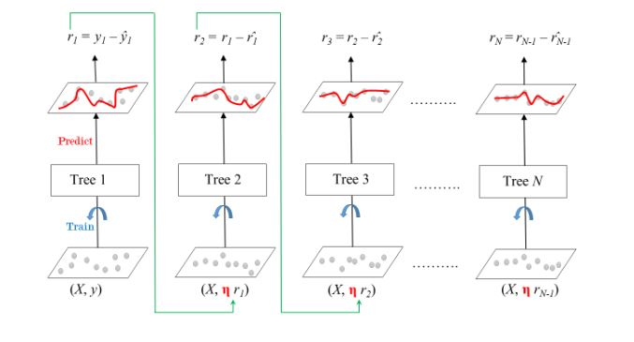
Training Gradient boosted tree:

Slide 31
Pros :
Gradient based methods generally giv better results but they are harder to fit than Random Forests
They provide a reliable feature importance estimate.
Invariant to scaling of inputs (no feature scaling needed)
Learn higher order interaction between features
Cons :
More hyperparameters to train (shrinkage param, depth of tree, number of estimators…)

